Slide 1
Feast of theSacred Heart
Association Mondiale des anciennes et anciens du Sacré Coeur (AMASC)

Slide 2
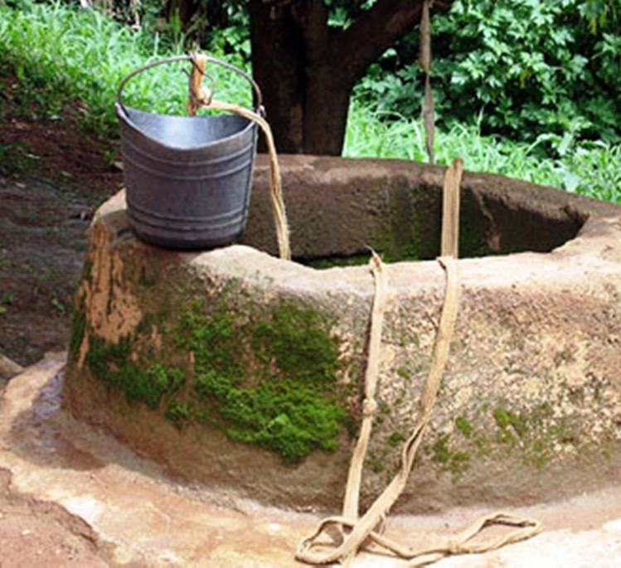
"They will draw from his heart esteem and love for poverty; the love of the virtue of charity and the way of practicing it; joy, true love;” light and grace; the spirit of humility, simplicity and obedience ... You will find everything in the Heart of Jesus, which is open for us; let's go to him to get the strength and the courage we need. "
(Constitutions of 1815)

Slide 3
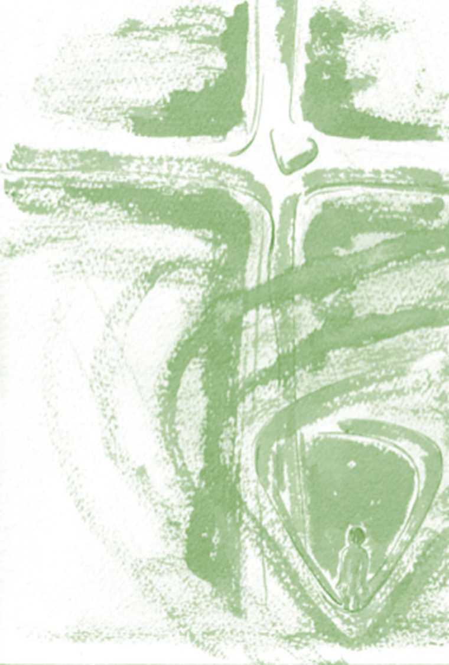
Madeleine Sophie invites us to go again and again towards the heart of Jesus, to know him, to love him and that our heart can be like his. How is the Heart of Jesus? do we know him enough?

Slide 4
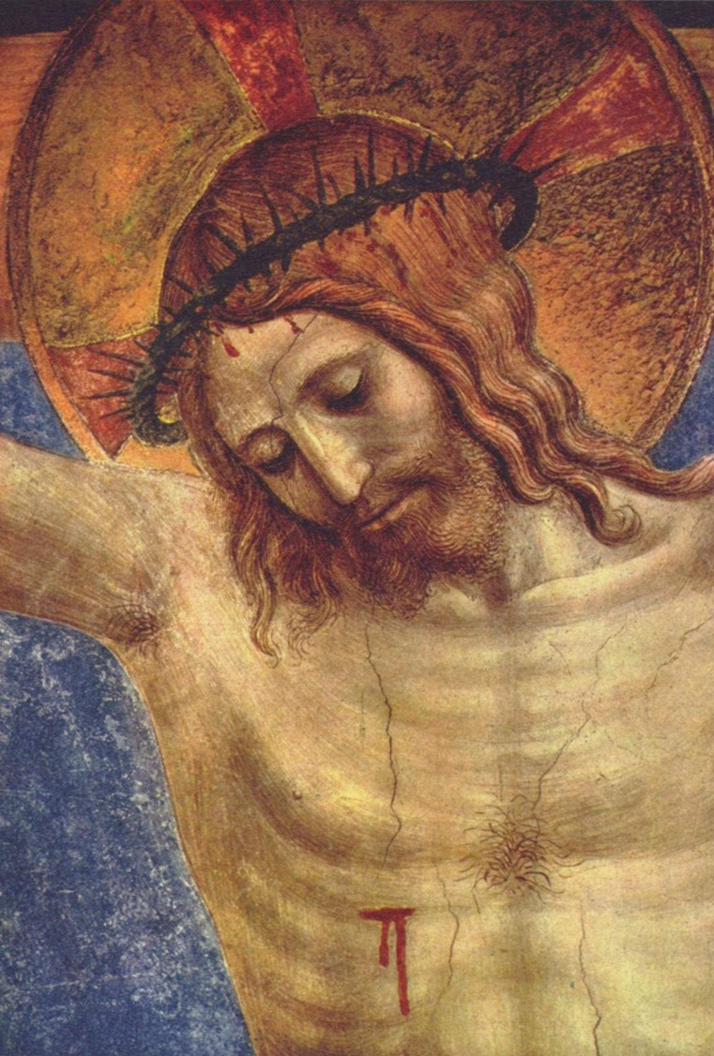
It is a PIERCED heart that reflects the face of the love of our God, who loved us so much, even giving his life for us.

Slide 5
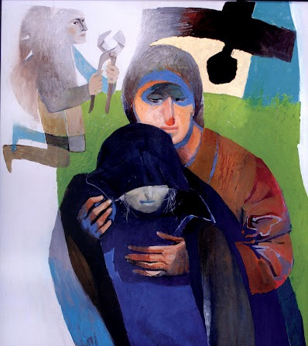
It is a heart that SUPPORTS and LISTENS. He is always attentive. Under his regard we are happy, knowing that Jesus is with us.

Slide 6
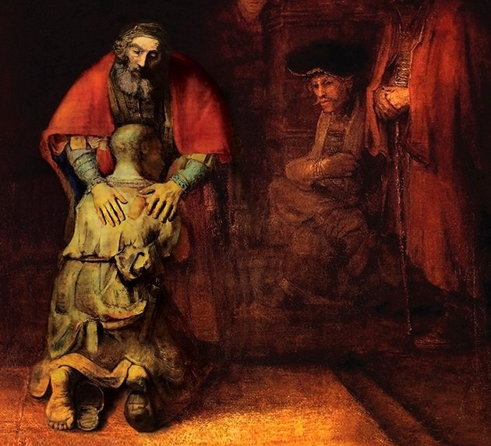
It is a heart that FORGIVES, for it is full of tenderness and mercy. Jesus renews our life and invites us to have a heart similar to his.

Slide 7
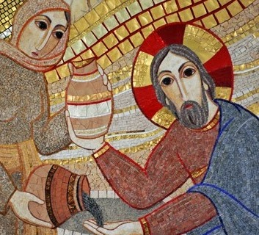
It is a heart that gives us WORDS OF LIFE that lights our way and accompany us every day.

Slide 8
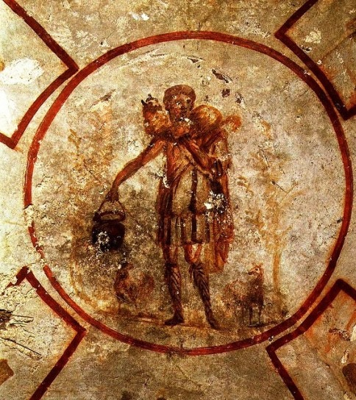
It is the heart of a GOOD SHEPHERD, which has the heart of a father and a mother, bringing us by green meadows and safe paths.

Slide 9
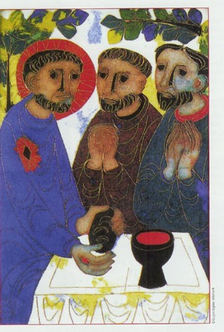
It is a FORTUNATE heart that gives us everything we need, with endless love.

Slide 10
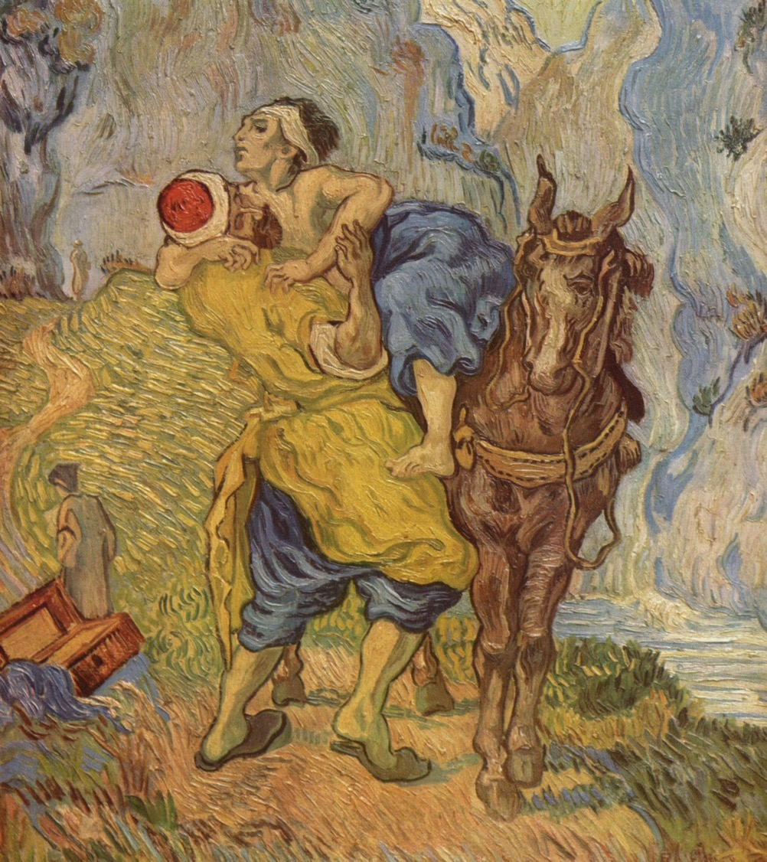
It is a heart of the God of mercy and compassion, who shows his kindness and who listens to us.

Slide 11
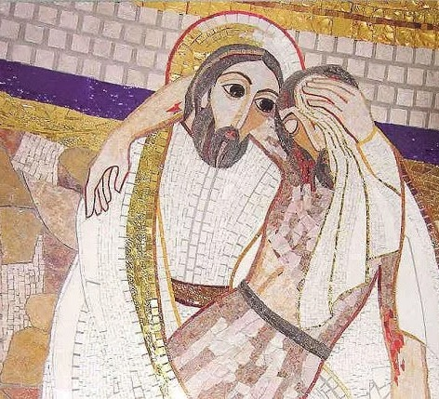
It is a heart that WELCOMES the simple and the weak, who bows to hear his voice, who welcomes him and accompanies them.

Slide 12
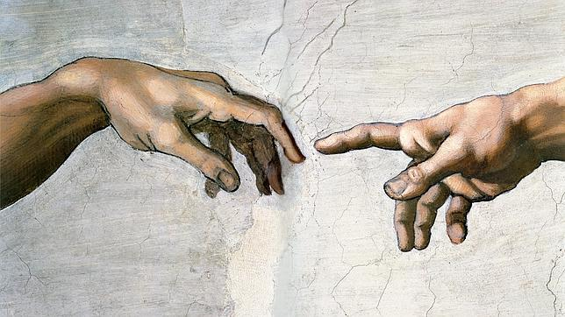
It is a heart that BLESSES us with LOVE and tells us about his kingdom.

